Slide 1

Economic Impacts of RGGI:
Following the Dollars
Paul J. Hibbard
The Economic Impacts of the Regional Greenhouse Gas Initiative on the Ten Northeast and Mid-Atlantic States
Raab Roundtable – February 2012

Slide 2
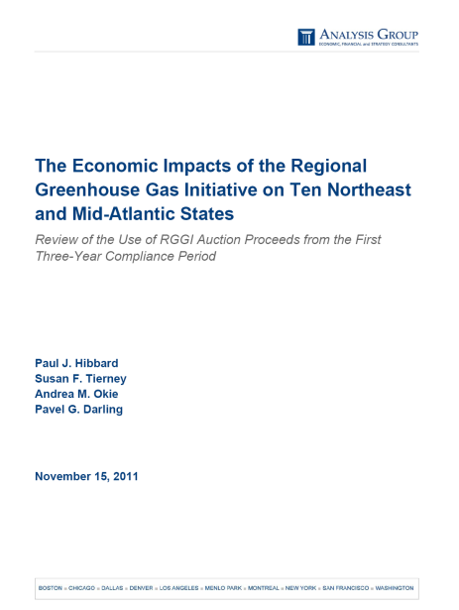
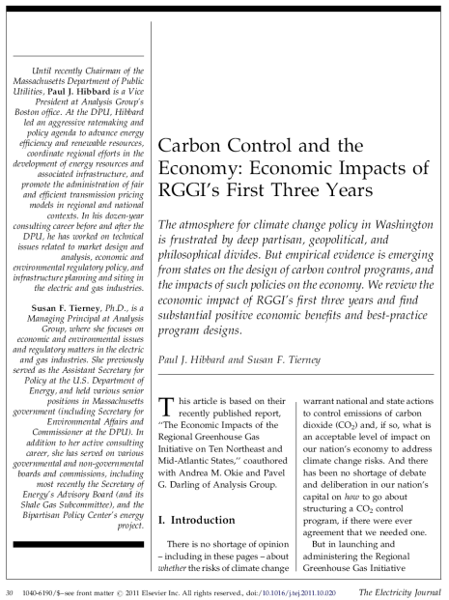
Study of the Economic Impacts of RGGI
Foundation- Funded Study (11-2011):
  Only requirement from the funders: independent, with full editorial control by Analysis Group team
  Team: Paul Hibbard, Sue Tierney, Andrea Okie, Pavel Darling
Electricity Journal Article (12-2011)
Technical Advisory Group
  David Conover, Sr. VP, Bipartisan Policy Center
  Richard Corey, Chief, Stat Source Div, CARB
  Nathan Hultman, Director, Environmental Policy Program, School of Public Policy, University of MD
  Brian Jones, Sr. VP, M.J. Bradley & Associates
  John “Skip” Laitner, Director, Economic and Social Analysis, ACEEE
  Michelle Manion, Climate & Energy Team Leader, NESCAUM
  Brian Murray, Director for Economic Analysis, Nicholas Institute, Duke University
  Karen Palmer, Senior Fellow, RFF
  Eric Svenson, Sr. VP, Policy and Environment, Health and Safety, PSEG
  Alexander “Sandy” Taft, Director, U.S. Climate Change Policy, National Grid

Slide 3

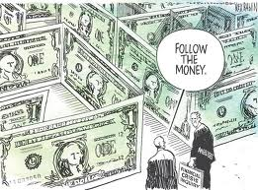
What the study is…
What the study is not…
Review of carbon reduction benefits
Review of environmental impacts
Evaluation of need for a carbon control program
Forecast of future program participation, effectiveness, results
Assessment of appropriateness of cap level
Analysis of carbon market
Economic study
  …of actual revenues, actual programs, actual impacts
Following the money
…through the electric sector
…and through the macro economy
Measuring results

Slide 4
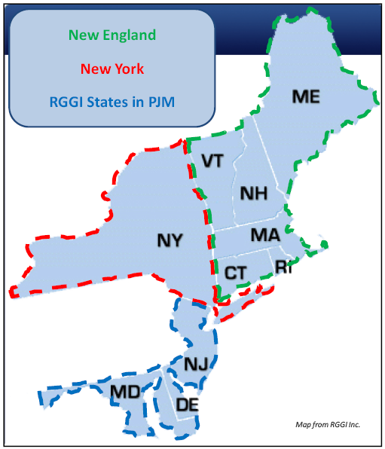
Bottom line results:
Net positive economic impacts for:
  the 10 RGGI states together, and for each state participating in RGGI
  Across the region, the initial $0.9 billion in CO2 allowance auction proceeds translates to $1.6 billion in net economic value added
Economic value results from the various ways states spent auction proceeds:
  Biggest economic bang for buck: energy efficiency program support
  Economic value also created by other ways money recirculates in local economies (e.g., customer bill rebates, general fund contributions)

Slide 5
Study Approach: Following the Money….
  Dollar Flows from RGGI Auction Proceeds through State Spending Impacts
$912 million over 3 years
Different states
  Different programs
  Different agencies
  Different tracking methods
  Different assumptions
Impacts (+ and -) in electric sector and larger economy during first three years of RGGI (2009-2011)
Impacts in electric sector and larger economy (2009-2021)

Slide 6
Run the $ Through the Power System and the Economy…
GE MAPS
IMPLAN
  Flow of Data
  and Modeling
  Outcomes

Slide 7
Auction and Direct Sales Proceeds
$912 M
Downward trend in auction proceeds from 2009-2011 results from:
Fewer allowances sold over time
Lower allowance prices over time

Slide 8
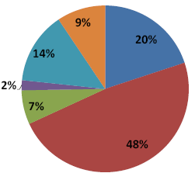
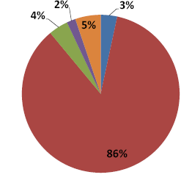
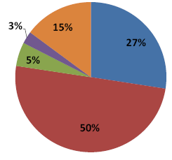
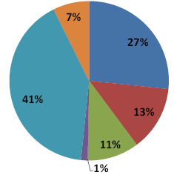
Use of RGGI auction proceeds ($912 million) across the 10 states and in the 3 electric regions
10 RGGI states 6 New England States
New York (NYISO) DE, MD, NJ (PJM)
Source: Individual state reports and interviews.
Note: Certain grant programs may include multiple components,
and are categorized in the figure above based on the largest share of spending.

Slide 9
Overall economic impacts – 10 states
$1.6 billion – economic value added in the region (NPV*)
$0.9 billion – auction proceeds (mid-2008 through Q3 2011)
$1.1 billion – consumer savings (electricity customers) (NPV*)
$0.17 billion – consumer savings (natural gas & oil heat customers) (NPV*)
$1.6 billion – lower revenues to power plant owners (NPV*)
$0.77 billion – fewer dollars spent on out-of-region fossil fuel (NPV*)
16,000 jobs – jobs created
0.7 percent – average electricity bill increases during 3-year RGGI period [with savings over time given energy efficiency implemented with RGGI funds]
* Using a 3% social discount rate

Slide 10
Total Economic Impact – Value Added and Job-Years

Slide 11
New England
New York
PJM States
(DE, MD, NJ)

Slide 12
Value Added Multipliers: Average impacts within RGGI states
Energy Efficiency:
Combines these various elements

Slide 13
  Top 3 take-aways
  RGGI cap/trade program integrated well with electric markets, and generated positive economic value, because…
  Allowances were auctioned, capturing value for public use
  Majority of funds used in ways that maximized economic benefit (energy efficiency)

Slide 14
  A mandatory, market-based carbon control mechanism is functioning properly and can deliver positive economic benefits
  Program has integrated seamlessly in regional power markets
  States have collected/disbursed revenues, and worked cooperatively
  RGGI reduces region’s payments for out-of-state fossil fuels
  Reduced generation (due to lower consumption) reduces payment for fuels
  Represents additional funds that stay mostly within state economies
  A Region’s existing generating mix affects economic impacts
  Carbon intensity of resource mix affects magnitude of impacts on revenues for power sector

Slide 15
  The design of the CO2 market in the RGGI states affected the size, character, and distribution of public benefits
  Decision by RGGI states to auction allowances transfers emission rights from public to private sector at a monetary cost
  Retains value of allowances – and generates substantial revenue – for public use (preventing transfer of that value to plant owners)
  Price impacts on electric markets the same either way

Slide 16
  How allowance proceeds are used affects their economic impacts
  States used funds in different ways, providing a wide variety of public benefits not captured in economic analysis
    This does not decrease the value of different investment vehicles
  However, how funds are used does affect economic impact
    Energy efficiency investments have strongest positive economic impact
      Reduces consumption (particularly for participants)
      Depresses wholesale prices (for all)
      Keeps impacts largely within electric sector
    Other investments have strong returns, transferring value to other sectors of the economy
      Direct bill assistance
      General fund contributions
      Education and job training

Slide 17
  Positive job impacts with RGGI
  Results in thousands of jobs more than non-RGGI case
    16,000 “job-years”
    Reflects direct, indirect, induced jobs
    Some may be temporary, others longer term
    All associated only with first three years of program investments (but occur throughout the study period)
  Jobs spread around economy, e.g.
    Personnel doing energy efficiency audits
    Installers of energy efficiency measures or renewable projects
    Trainers, educators
    State workers whose responsibilities might otherwise be eliminated due to budget challenges

Slide 18
  RGGI’s first 3 Years of program investments point to some best practices
  More rapid movement of revenues to investment vehicles speeds realization of benefits
  Energy efficiency dominates benefit calculus
  Standardization of tracking, measuring and verifying spending and results could reduce administrative burden of tracking progress and measuring benefits/costs
    States have done a good job
    But variation across states makes consistent tracking challenging

Slide 19

  The states have used CO2 allowance proceeds creatively – supporting diverse policy and economic outcomes
  Use of RGGI revenues has allowed states to meet a wide variety of social, fiscal, and environmental policy goals
    Addressing budget challenges
    Assisting low-income energy consumers
    Restoring wetlands
    Promoting advanced energy technologies
    Assistance to municipalities and businesses through renewable and energy efficiency funding

Slide 20
Paul J. Hibbard
Analysis Group
111 Huntington Avenue, 10th Floor
Boston, MA 20199 phibbard@analysisgroup.com
617-425-8171

